Slide 1
Dr. Yifeng Zhu Electrical and Computer Engineering University of Maine
Embedded Systems
Lab 4:
SPI: Serial Peripheral Interface
Spring 2019

Slide 2
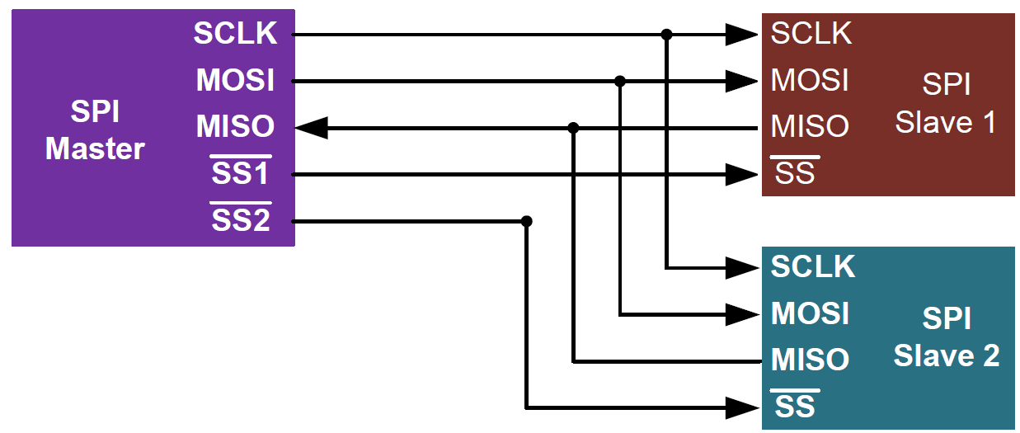
Serial Peripheral Interface (SPI)
Synchronous full-duplex communication
Can have multiple slave devices
No flow control or acknowledgment
Slave cannot communicate with slave directly.
SCLK: serial clock
SS: slave select (active low)
MOSI: master out slave in
MISO: master in slave out

Slide 3
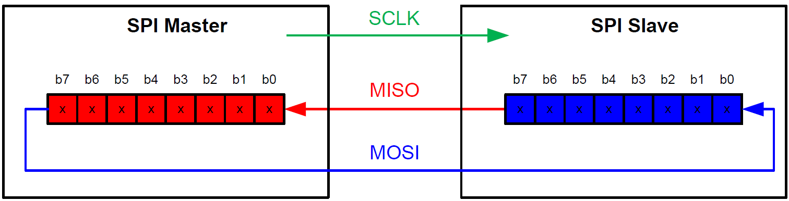
Data Exchange
Master has to provide clock to slave
Synchronous exchange: for each clock pulse, a bit is shifted out and another bit is shifted in at the same time. This process stops when all bits are swapped.
Only master can start the data transfer

Slide 4
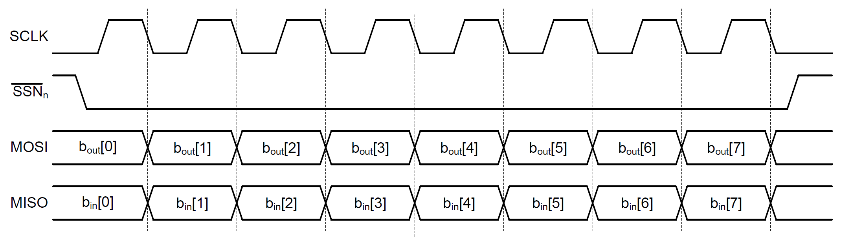
Clock

Slide 5
Clock Phase and Polarity
CPOL = 0 ⟶ SCLK is pushed to low during idle. Otherwise, pulled to high during idle.
CPHA = 0 ⟶ the first clock transition (either rising or falling) is the first data capture edge. Otherwise, the second clock transition is the first data capture edge.
Combination of CPOL and CPHA determines the clock edge for transmitting and receiving.

Slide 6
Clock Phase and Polarity

Slide 7
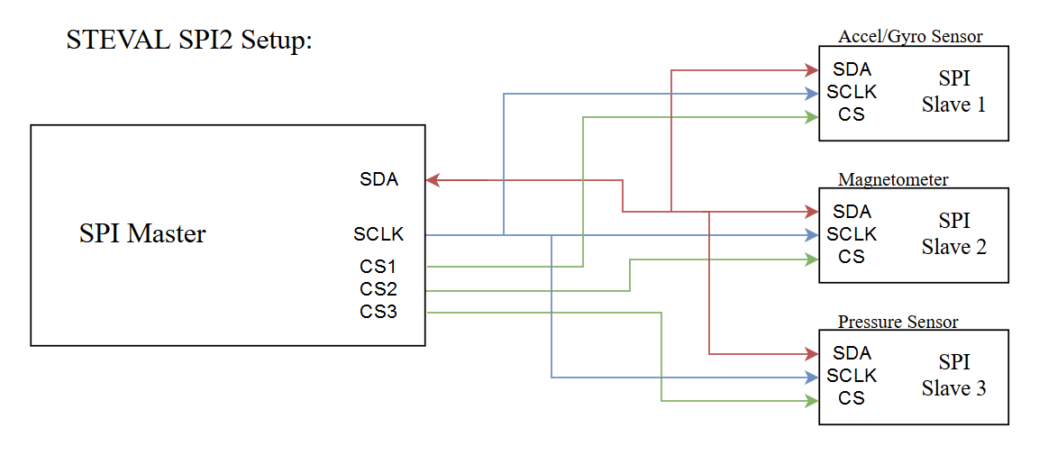
SPI on the STEVAL
The STEVAL uses SPI to communicate with its various sensors
The STM32F4’s SPI2 interface is connected to the sensors according to the following diagram

Slide 8
STEVAL SPI Protocol
The STEVAL has three sensors connected on one SPI interface
SPI messages are broadcast to all three sensors simultaneously. Sensors only listen when their CS line is low.
The MISO and MOSI lines are combined into a single SDA line
Data is only received after a transmission asking for said data is completed, data can only move in one direction at a time
The SPI transactions occur based on the SCLK line, driven by the STM32F4’s clock
Notes:
TODO: Probably should add an image here, and reduce text

Slide 9
The Lab:
The objective of Lab 4 is to configure the SPI2 interface on the STM32F4 to receive data from the sensors
Both the SPI interface and the associated GPIOs will need to be configured appropriately
The output data will be checked using the STEVAL’s companion app

Slide 10

Before the Lab:
Before this lab, please download the STEVAL Drone application onto your Android smartphone
The app is called ST BLE Drone and can be found on the Google Play Store
Instructions concerning the use and configuration of the app can be found in the lab handout

